Slide 1
Deal Overview
COMPANY NAME:
COMPANY LOCATION:
INDUSTRY:
COMPANY DESCRIPTION:
YEAR FOUNDED:
TEAM SIZE:
ANNUAL REVENUE:
ANNUAL EBITDA:
LATEST SDE:
DEAL FOLDER LINK:

Slide 2
Offer
OVERVIEW:
Summary of the offer; save the discussion for specifics at the end on "Offer Specifics" slide.

Slide 3
Due Diligence Summary
Current Ownership | Temp
Customers | Temp
Customer Acquisition Strategy | Temp
Competition | Temp
Talent | Temp
Growth Opportunities | Temp
Industry Moat | Temp
Company Moat | Temp
Pricing Health | Temp

Slide 4
Organizational Chart
PLACE COMPANY ORG CHART HERE.

Slide 5
Key Management & Personnel
PLACE INFO HERE.

Slide 6
Facilities & Location
PLACE INFO HERE.

Slide 7
Reputation
PLACE INFO HERE.

Slide 8
Demographics
OVERVIEW:
TEMP
TEMP
OPPORTUNITIES:
TEMP

Slide 9
Industry Dynamics
OVERALL INDUSTRY GROWTH:
INDUSTRY GROWTH IN SERVICE AREA:

Slide 10
Risks & Mitigants
Risks | Mitigants
Temp | Temp
Temp | Temp
Temp | Temp

Slide 11
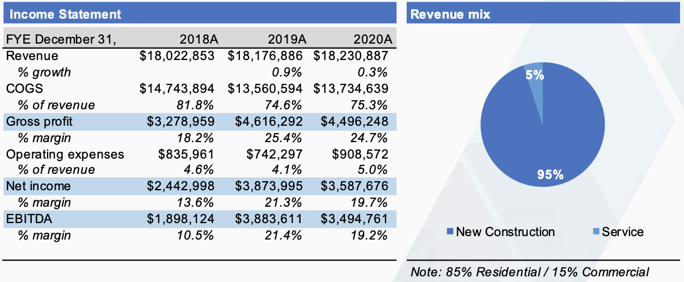
Financial Performance
EXAMPLE
~30MM in project revenue in the 2021 pipeline
2 biggest customers expected to account for ~25% of 2021 revenue
Notes:
air mattresses and pressure relief products for therapeutic and wound healing treatment
air mattresses and pressure relief products for therapeutic and wound healing treatment

Slide 12
Seasonality
 | Revenue/Mo
January | 0%
February | 0%
March | 0%
April | 0%
May | 0%
June | 0%
July | 0%
August | 0%
September | 0%
October | 0%
November | 0%
December | 0%
OVERVIEW:
Explain the company’s seasonality, if any.
BREAKDOWN:
RISKS:
MITIGATION STRATEGIES::

Slide 13
Customer Concentration
OVERVIEW: List each customer who provided 10% or more of revenue in the latest year. Was this one-time revenue or does it recur each year? One-time revenue is of interest, but not a big issue.
MITIGATION STRATEGIES FOR RECURRING REVENUE:
Customer Identifier | Type (If Applicable) | 2020% | 2021% | 2022% | 2023% YTD | Average %

Slide 14
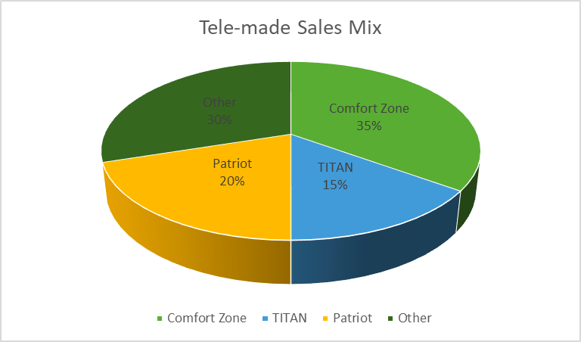
Sales Segmentation
OVERVIEW:
Explain how sales are segmented - eg., new construction vs. service, commercial vs. residential, insurance-paid vs. non-insurance .
RISKS:
MITIGANTS:
EXAMPLE

Slide 15
Acquisition Entrepreneur Fit
OVERVIEW:
LIKES:
DISLIKES:
UNFAIR ADVANTAGE(S):
RELOCATION REQUIRED?

Slide 16
Offer Scenarios
OVERVIEW:
DISCUSS POSSIBLE TERMS.

Slide 17
Financial Forecast
OVERVIEW:
LINK TO PRO FORMA FINANCIALS:
LINK TO P&L:
LINK TO FINANCIAL MODEL:

Slide 18
Intrinsic Value Calculations
OVERVIEW:
LINK TO INVESTMENT THESIS CALCULATOR:
https://docs.google.com/spreadsheets/d/1P-bgU1KSdbNDi-k-LRjfbdHdmWG2Va-70nsN-UFiWeI/edit?usp=sharing

Slide 19
Link to SBA Model Calculator

